Slide 1


GitHub for Fisheries Scientists
AFS-AK Chapter Workshop
February 23, 2022
12:00–1:30 PM
Instructors: Justin Priest and Sara Miller
https://github.com/justinpriest/github_demo_adfg

Slide 2


Welcome! Your Instructors:
Justin Priest
ADF&G Fisheries Biologist 3
Sara Miller
ADF&G Biometrician 3
Notes:
Introduce myself and then JP introduces himself.

Slide 3
Overview
1 – What is GitHub
2 – Why use GitHub?
3 – How to use GitHub
4 – Show me the demo!
5 – Concluding Thoughts / Best Practices / Resources
Notes:
These first two sections will hopefully convince you of the benefits of GitHub, the next two will demonstrate the installation process and basic usage, and the last section will leave you with some resources to peruse.

Slide 4
1 – What is GitHub?
Notes:
So, what is GitHub?

Slide 5

1 – What is GitHub?
Git is the underlying tech
Integrates a version control program into other programs
Backend (behind the scenes)
GitHub is a specific site
Other sites too (e.g., GitLab and BitBucket)
Front end (website interface)
Notes:
Git is the underlying technology that integrates a version control program into other programs. GitHub is a specific site. GitHub integrates well with R and R Studio.
Pacific Salmon Commission uses GitLab so Taku River sockeye and Stikine River sockeye projects are located here

Slide 6

1 – What is GitHub?
GitHub is a website that syncs with software on your computer to upload your files to github.com
Notes:
Screenshot of website
Similar to google drive or dropbox.

Slide 7
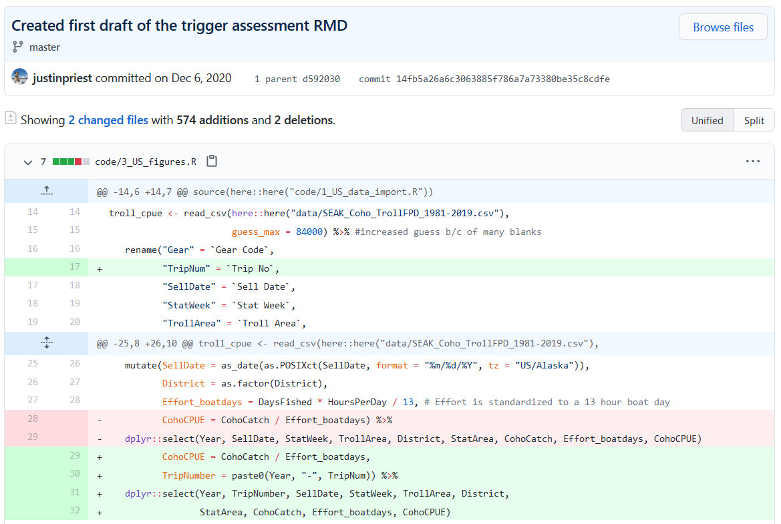
1 – What is GitHub?
Git is versioning control software
This means we can keep track of new additions (in green) and deletions (in red)
Later, we’ll cover more about benefits

Slide 8
2 – Why Use GitHub??
Notes:
Everyone has their own workflow.

Slide 9
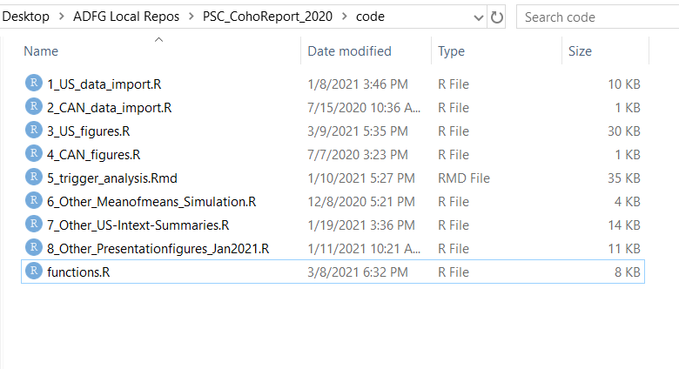
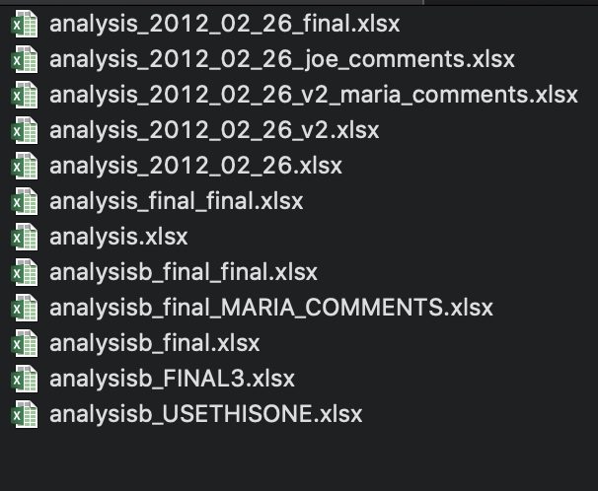
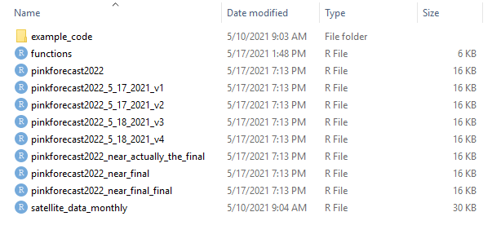

2 – Why use GitHub: Version Control
Versioning: The bane of digital file storage
Enter Version Control!
credit: Julie Lowndes & Allison Horst

Slide 10




2 – Why use GitHub?
GitHub helps scientists with:
Code sharing
Version control helper
R file
R file
R file
V1
R file
V2
R file
V3
V9
Project & data analysis storage

Slide 11
2 – Why use GitHub?
As scientists, we can use GitHub over a project’s lifecycle:
Archive final data
Record analysis versions
Back up our analysis files
Collaborate with coauthors
Show results to others – reproducible
Share analysis when we publish (link to repo)!
Notes:
Link to repo when publish manuscript
Private or public repo- herring (contentious assessments)

Slide 12
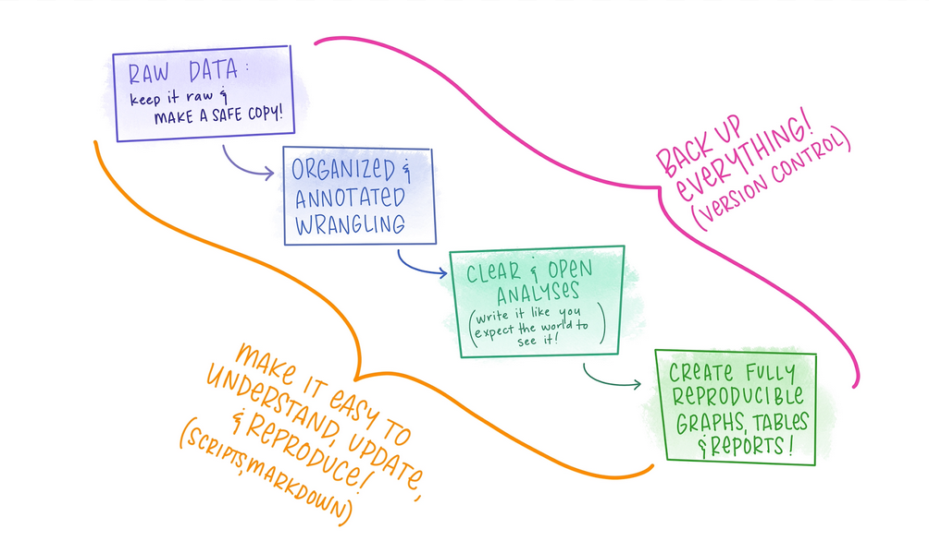
Figure: Allison Horst
Notes:
Put another way, our goals are to create analysis that is easy to understand & reproduce. For our own sanity, we would like to make sure that we don’t have 1000 versions of everything.

Slide 13
3 – How To Use GitHub
One time setup & daily usage

Slide 14
3 – A bit of Jargon
repo (repository)
remote
local
clone
pull
push
commit
fork
=
=
=
=
=
=
=
=
a “folder” containing an individual project
the repo on github.com
the repo on your computer
copy the remote repo to your computer
fetching in changes or merging them
send changes to a remote repo
individual change to a file
copy of a repo (allows you to freely experiment with changes without affecting the original project)

Slide 15


3 – A bit of Jargon
Local
Repo
Remote
Clone

Slide 16
3 – How to use GitHub: Setup
One Time Setup, part 1
Get a free account from github.com
Download & install the program “git”
Note the folder where this installs. In Windows common places are C:\Users\jtpriest\AppData\Local\Programs\Git (change to your username) C:\Program Files\Git
Accept all default settings and click through until installed.
Notes:
We won’t spend too long on this part because hopefully you did this ahead of time! If you followed all directions and still can’t get it figured out, email me after class

Slide 17
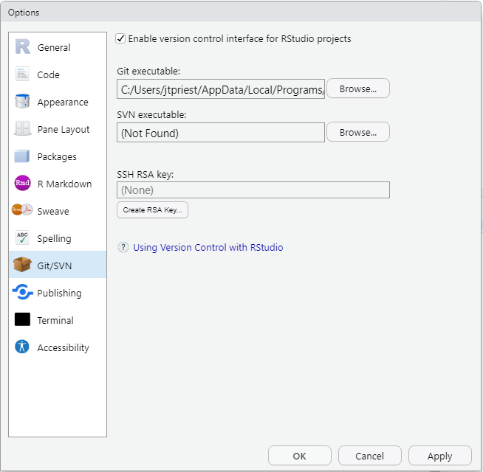
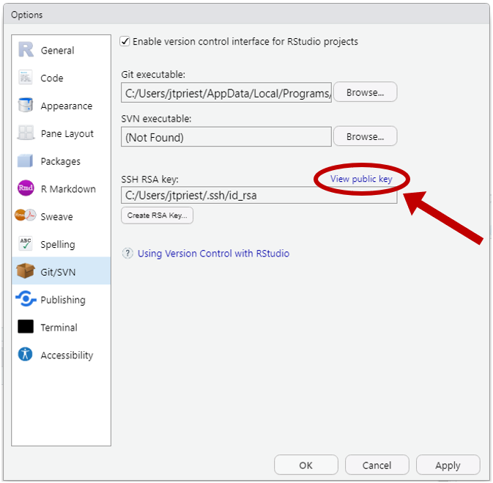
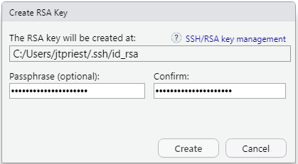
3 – How to use GitHub: Setup
One Time Setup, part 2
In RStudio, under Tools, -> Global Options ->“Git/SVN”
In the window that pops up, select “Enable version control interface for RStudio projects”.
Under “Git executable” click browse and select the correct folder noted before. Select the git.exe file, typically found in folder “bin”.
Next click “Create RSA Key”. Note folder location. Give it a memorable password, then click Create. Once it is done, you’ll see some random art and file info. Click Close.
Now you’ll want to open up and view this key. Click the small blue “View public key”. At this point you’ll see some random text that starts with “ssh-rsa”. Copy this!
Open up github.com and go to your profile settings
Click on “SSH and GPG keys” on the left. Click the green “New SSH key” button. Paste the key from RStudio in the key section. Give this key a unique title describing which computer you’re using.
Notes:
(This is where it can be helpful to have Windows show you file extensions).
(What we’re doing here is a creating a “key” that will allow RStudio to know that this computer is definitely you!)

Slide 18
3 – How to use GitHub: Setup
One Time Setup, part 3
In RStudio, install and load package “usethis”. Run this code
library(usethis)
use_git_config(user.name = “Your Name”, user.email = “your.email@alaska.gov”)
git_sitrep() # This shows current name, directory, and other settings
Yes, you do have to change these!
Notes:
Keep the quotes

Slide 19
3 – How to use GitHub: Setup
Setup complete!
Only a little painful and you’ll never have to do that again!
Notes:
Final Sara slide

Slide 20
3 – How to use GitHub: New proj
How to set up a new project to work in
Step 1 – Create/choose repo on github.com
Project already exists on GitHub (“clone” it to your computer)
Go to repo webpage on GitHub and copy entire URL at the top (e.g., https://github.com/commfish/Chilkat_Sockeye); or
Click on green code button in the repo (https://...) OR
Create a new project
While logged in, click green “New” repo button or go to https://github.com/new
Give it a name, chose public/private, add readme, (optional license & gitignore)
Copy entire URL at top
Notes:
Justin takes over…JP shares his screen and I stop sharing.

Slide 21
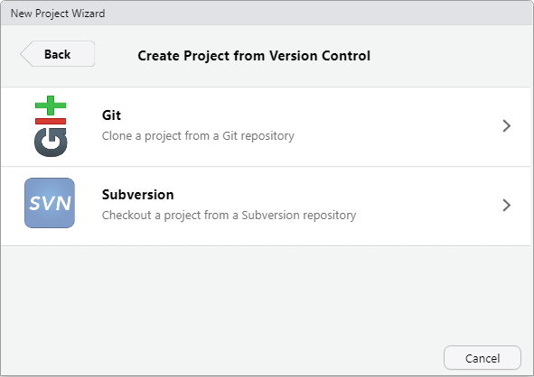
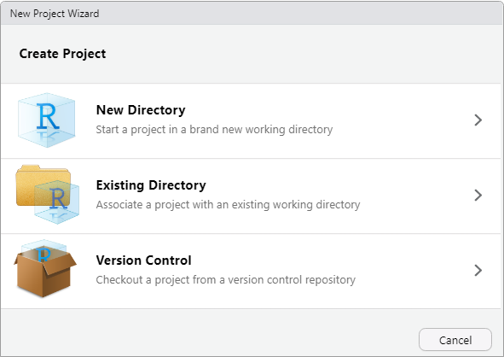
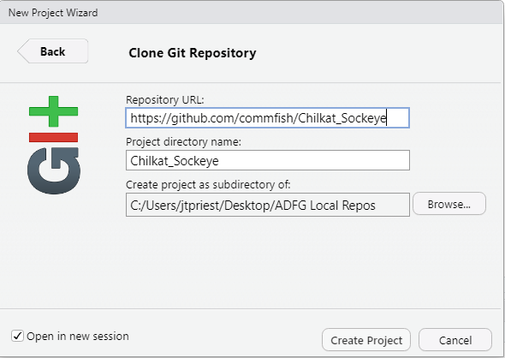
3 – How to use GitHub: New proj
How to set up a new project to work in (cloned project)
Step 2 – Connect RStudio Rproject to the repo
Open RStudio. Click File -> New Project -> Version Control -> Git. Paste in the github.com address into the Repository URL (https://github.com/commfish/Chilkat_Sockeye)
It auto fills Project Directory Name (this will be local folder name; change if you like). Set the directory where this folder will be. Open in a new RStudio session (or not).
Click Create Project and all files on GitHub repo will sync. If large project, might take a few min.

Slide 22
3 – How to use GitHub: Review
Review. We just:
Created a GitHub account
Connected our RStudio to this GitHub account
Synced an RProject with a github.com repo
This. Is. huge! Now onto daily usage

Slide 23

3 – A bit (more) Jargon
Commit
Prepping your changes for upload
Pull
Push
Download changes from github.com
Upload commits to github.com
Perform them in this order!
Notes:
This might not make a lot of sense quite yet, but we’ll walk through it!

Slide 24
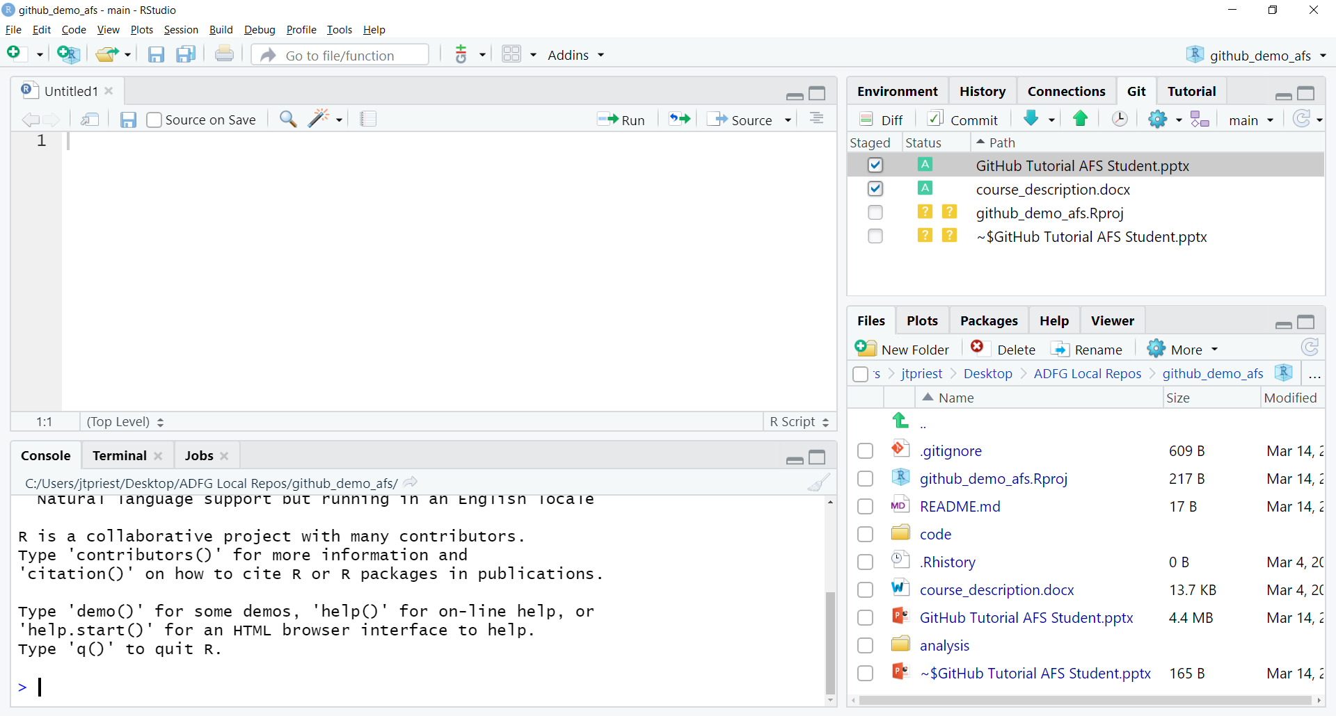

Slide 25
Box Color Meaning
?
Untracked
Modified
Added
Renamed
Deleted
M
A
R
D

Slide 26
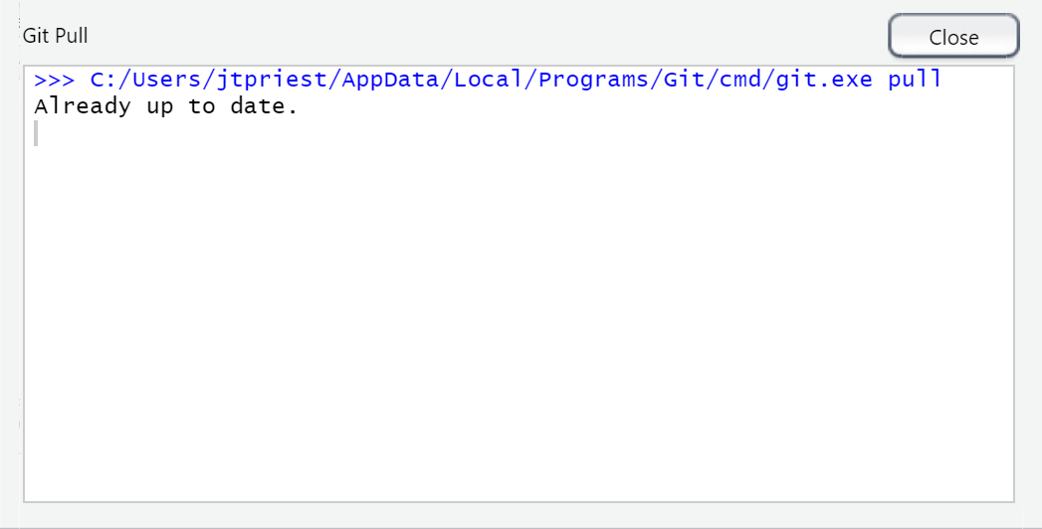
Pull First!

Slide 27
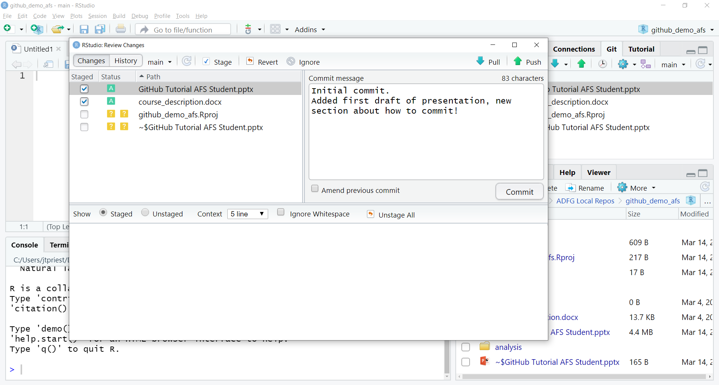
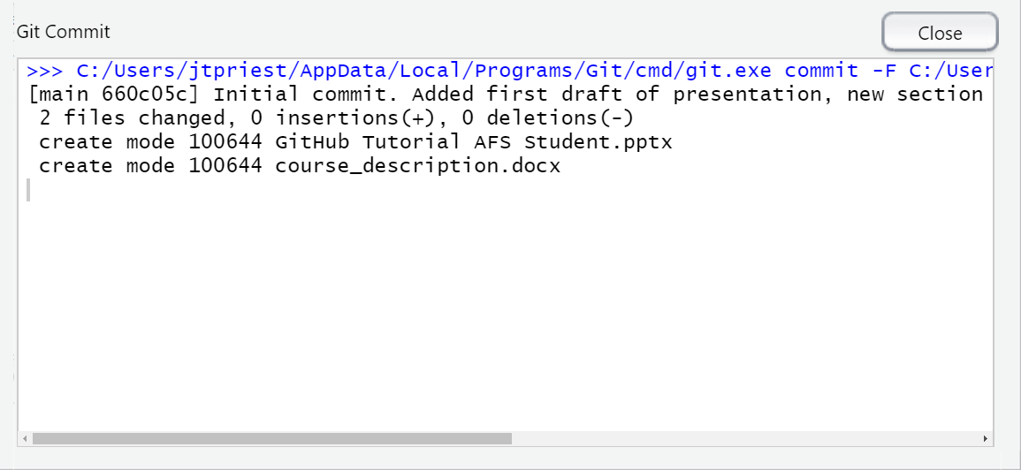
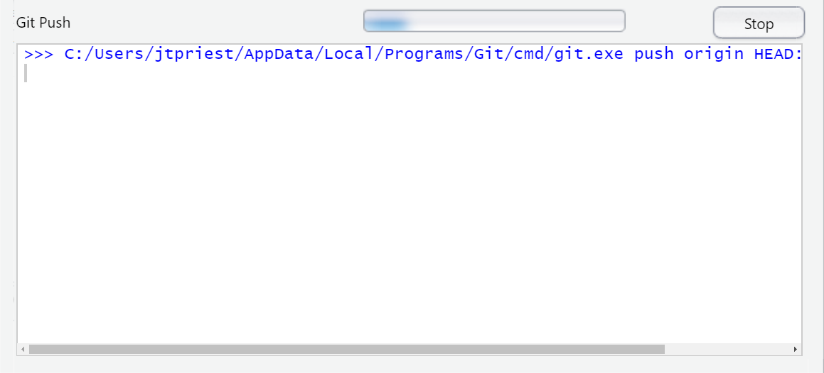
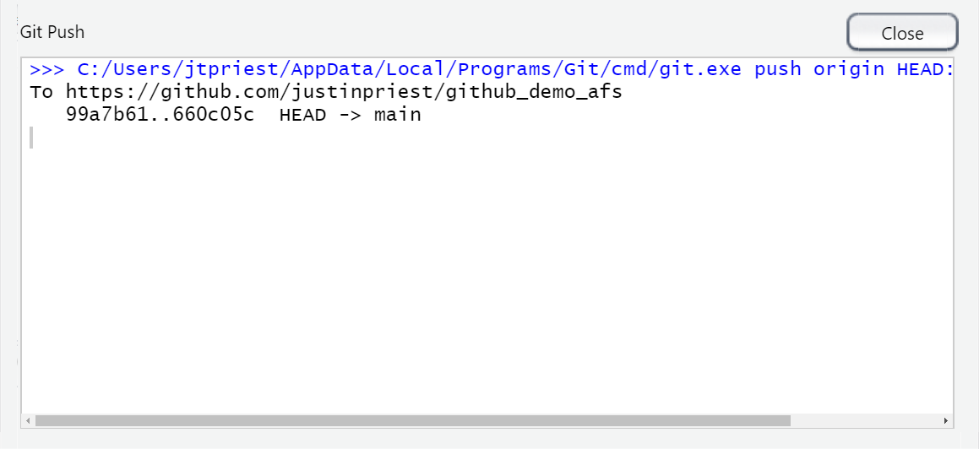
Success!

Slide 28
3 – How to use GitHub: Commits
Commit message
Added text (green)
Deleted text (red)
Notes:
Remember this?

Slide 29
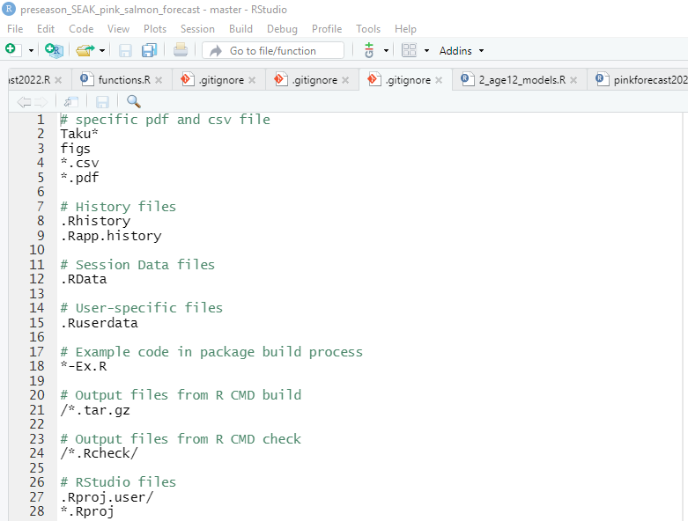
3 – How to use GitHub: Private data
How to deal with confidential data
Private repository (only invited individuals can see it)
Summarize data
Add to gitignore file
Don’t upload and add a readme file to the data folder (“Confidential data is not stored publicly. Contact someone@alaska.gov for access”)
Notes:
Remember this?

Slide 30
4 – Show Me the Demo!

Slide 31
4 – Demo 1: Creating a repo
1
Follow along as I share my screen

Slide 32
4 – Demo 2: Cloning an existing repo
2
Follow along as I share my screen

Slide 33
4 – Demo 3: Collaboration!
3
Follow along as I share my screen

Slide 34
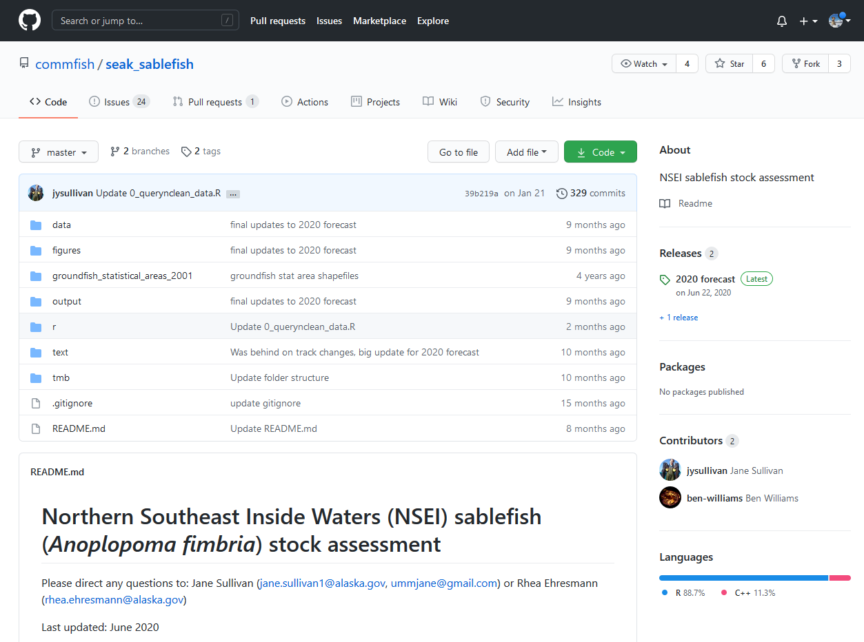
4 – Demo 4: Issues
https://github.com/commfish/seak_sablefish

Slide 35
5 – Concluding Thoughts / Best Practices

Slide 36
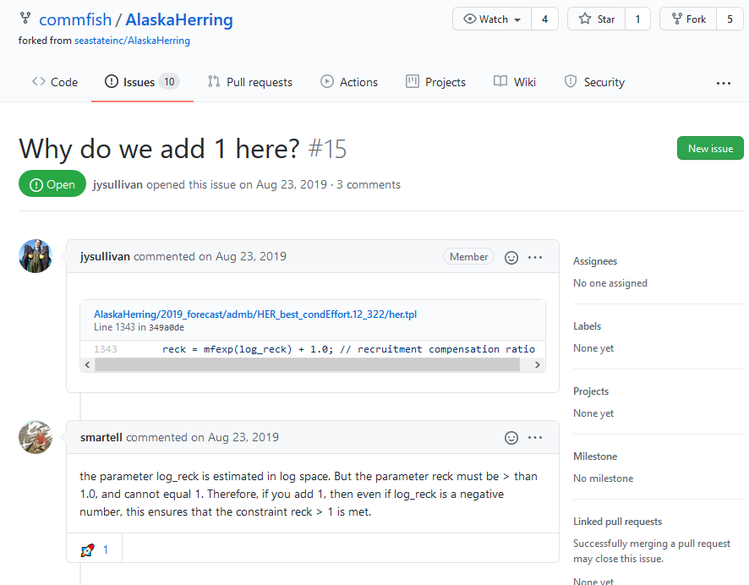
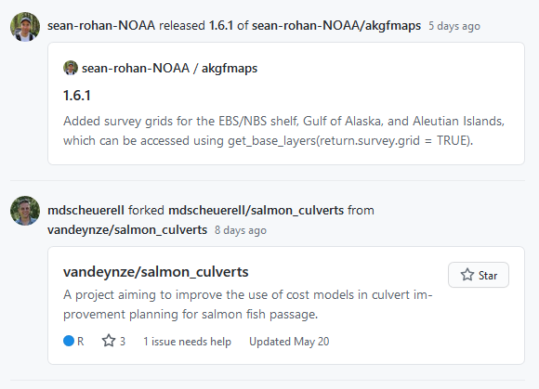



5 – What else can GitHub do?
We’ve barely shown the capabilities of GitHub
Issues can be assigned to people
“Fork” an existing repo to modify it to your purposes
Create a project website
Build and store an R package
Follow / learn others’ code
Add a “branch” to explore test features without modifying the main analysis

Slide 37

5 – Best Practices: CSVs
Git works best with “raw” or script-based files: R scripts, RMD presentations, CSV files, etc.
It works with MS Word, PowerPoint, .XLSX files, but difficult to compare changes
Takeaway: If you can, use CSV files!
VS
X
.XLSX

Slide 38



5 – Best Practices: Reading Data
It’s common to manipulate your data in Excel, save this file, then import/analyze in R
It’s MUCH better to do all cleanup in R
Saves steps for cleanup that are performed each time
Database
Database

Slide 39
5 – Best Practices: Naming
If possible, don’t use spaces, mixed cases, or periods in filenames or directories
Name data and R files descriptively
If you are changing files, then adding a date can be beneficial
Be consistent across projects
Use variables / column names that are:
Easy to understand
Short yet descriptive
Example:
X10_20.16_T_AND_Y410.csv
versus
taku_sockeye_age_comp.csv
Example:
sablefish_chathamsurvey_bio_1988_2016.csv
secm_survey_cpue_1988_2016.csv
Example:
year, catch instead of c
cohocatch2016
Source: ADF&G Biometrics Best Practices
Notes:
Final Justin slide

Slide 40
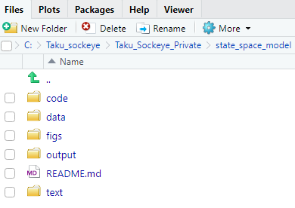
5 – Best Practices: Folders
Folder structure
code
All scripts go here (use separate folders for R code, admb, etc.)
data
Use raw data treat as a read only file; never adjust the contents of this file, access/modify via code only
Create a metadata text file describing all fields within the data files
figs
Output charts as .png here
output
results of analyses
text
if writing a document it is easier to keep separate
Source: ADF&G Biometrics Best Practices
Notes:
Sara takes over shares her screen. JP stops sharing screen.

Slide 41
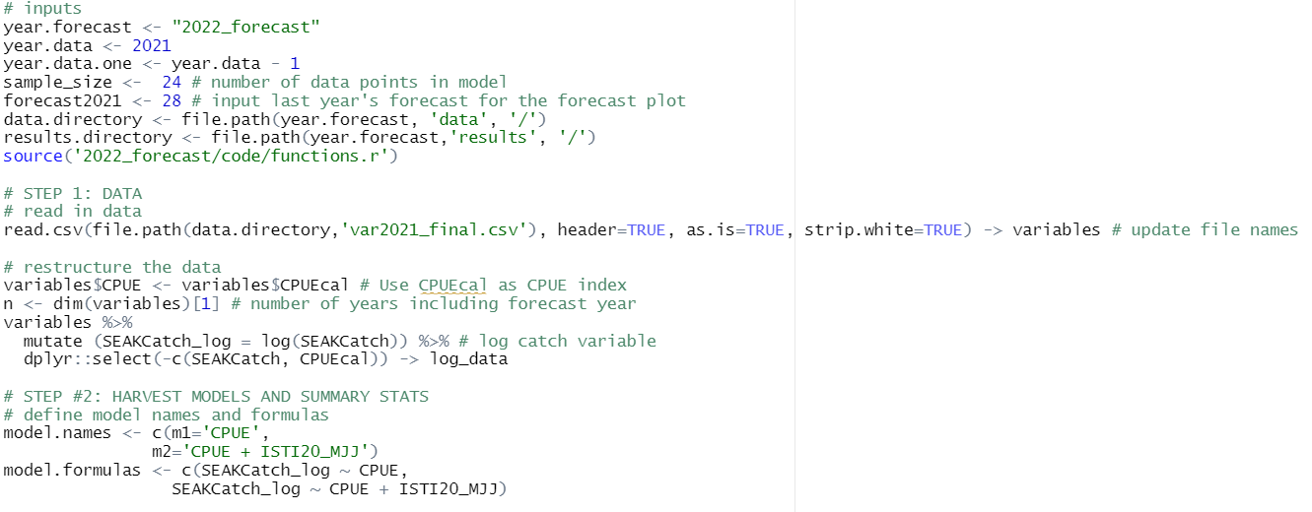
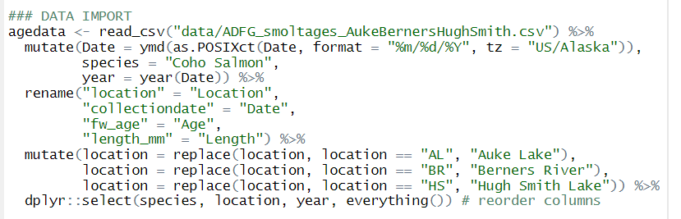

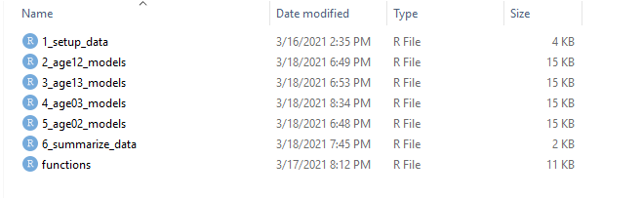
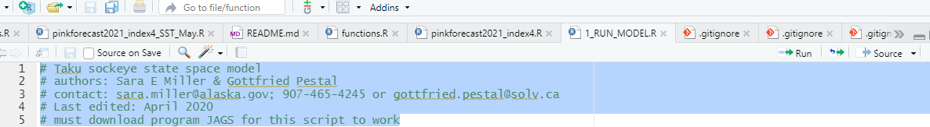
5 – Best Practices: Other
Avoid working in the same file as collaborators!
Update R versions and packages often
Unless you’re about to publish
Break up data import/cleanup & analysis scripts
Use several scripts that “link” together rather than a long script
Comment often and be VERY thorough
Follow people on GitHub / Twitter/Facebook to read other code and learn better coding practices
Read in data using read.csv() or read_csv(). Never use file.choose(), never use the “Import Dataset” wizard in RStudio. Keep file paths relative and not static
Notes:
Fish & Aquatic Sci Stats

Slide 42
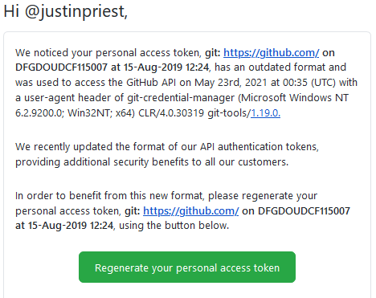
5 – Recent Update
If you are already a GitHub user and got this email:
In RStudio: Update packages “usethis”, “gh”, and “gitcreds”
In Email: Click “Regenerate your personal access token”
On GitHub.com: Click Regenerate token, copy text on next screen! (starts with “ghp_”)
In RStudio: Run “gitcreds::gitcreds_set()”, select “2: Replace these credentials”, paste in new token text
In RStudio: Run “usethis::gh_token_help()” to double check that everything looks good

Slide 43
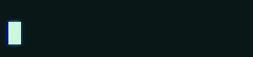
Remember!
Pull ->
Do your work ->
Pull ->
Commit ->
Push
Work
Commit
Pull
Pull
Push
My code:

Slide 44
Additional Resources
GitHub course for new users
Library “Usethis” Config and Setup for GitHub
Happy Git with R
GitHub for Advanced Ecological Data Analysis
R for Excel Users – Github brief intro

Slide 45
Troubleshooting
What if I have an existing RProject that I want to push to GitHub?
Technically it’s possibly to push an existing RProject to GitHub, but it gets tricky (requiring command line git). It’s simplest to create a new RProject, copy over files, and delete the old project.
I can’t push to GitHub!
Pull first. A collaborator probably made edits to the remote (GitHub.com) version and you need to grab that before you make any edits
How do I add a collaborator?
Go to the repo page on github.com and click settings -> Manage Access. Now they can push code to this same repo! Remember to work in the file separately and push/pull often!!
Notes:
Don’t need to read thru all these, just for reference for the future

Slide 46
Questions? Contact us!
sara.miller@alaska.gov
justin.priest@alaska.gov

